Slide 1
Project website and project management platform presentation
Ljiljana Jevremovic
University of Niš - UNI
Kick-off meeting ... Nis (SERBIA) ... 20th of December, 2018
This project has been funded with support from the European Commission. This publication reflects the views only of the author, and the Commission cannot be held responsible for any use which may be made of the information contained therein.

Slide 2
THREE TOPCIS TO PRESENT
SWARM PROJECT WEBSITE
PROJECT MANAGEMENT PLATFORM
SOCIAL MEDIA NETWORKING
Strengthening of master curricula in water resources management
for the Western Balkans HEIs and stakeholders
www.swarm.ni.ac.rs

Slide 3
WWW.SWARM.NI.AC.RS
to create A PUBLIC
IDENTITY
to offer up-to-date
INFORMATION
to establish public
COMMUNICATION
Strengthening of master curricula in water resources management
for the Western Balkans HEIs and stakeholders
www.swarm.ni.ac.rs

Slide 4
WWW.SWARM.NI.AC.RS
WEB BANNERS linking
SWARM PROJECT WEBSITE
to be put on the CONSORTIUM
MEMBERS’ WEBSITES
Strengthening of master curricula in water resources management
for the Western Balkans HEIs and stakeholders
www.swarm.ni.ac.rs

Slide 5
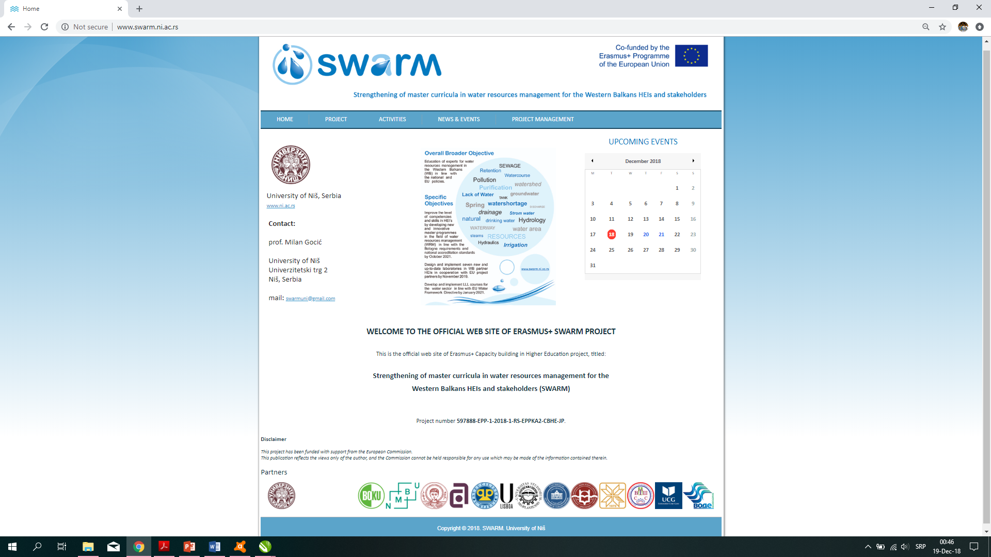
WWW.SWARM.NI.AC.RS
the main menu bar
events’ calendar
&
current announcements
links to the consortium
members’
official websites
Strengthening of master curricula in water resources management
for the Western Balkans HEIs and stakeholders
www.swarm.ni.ac.rs

Slide 6
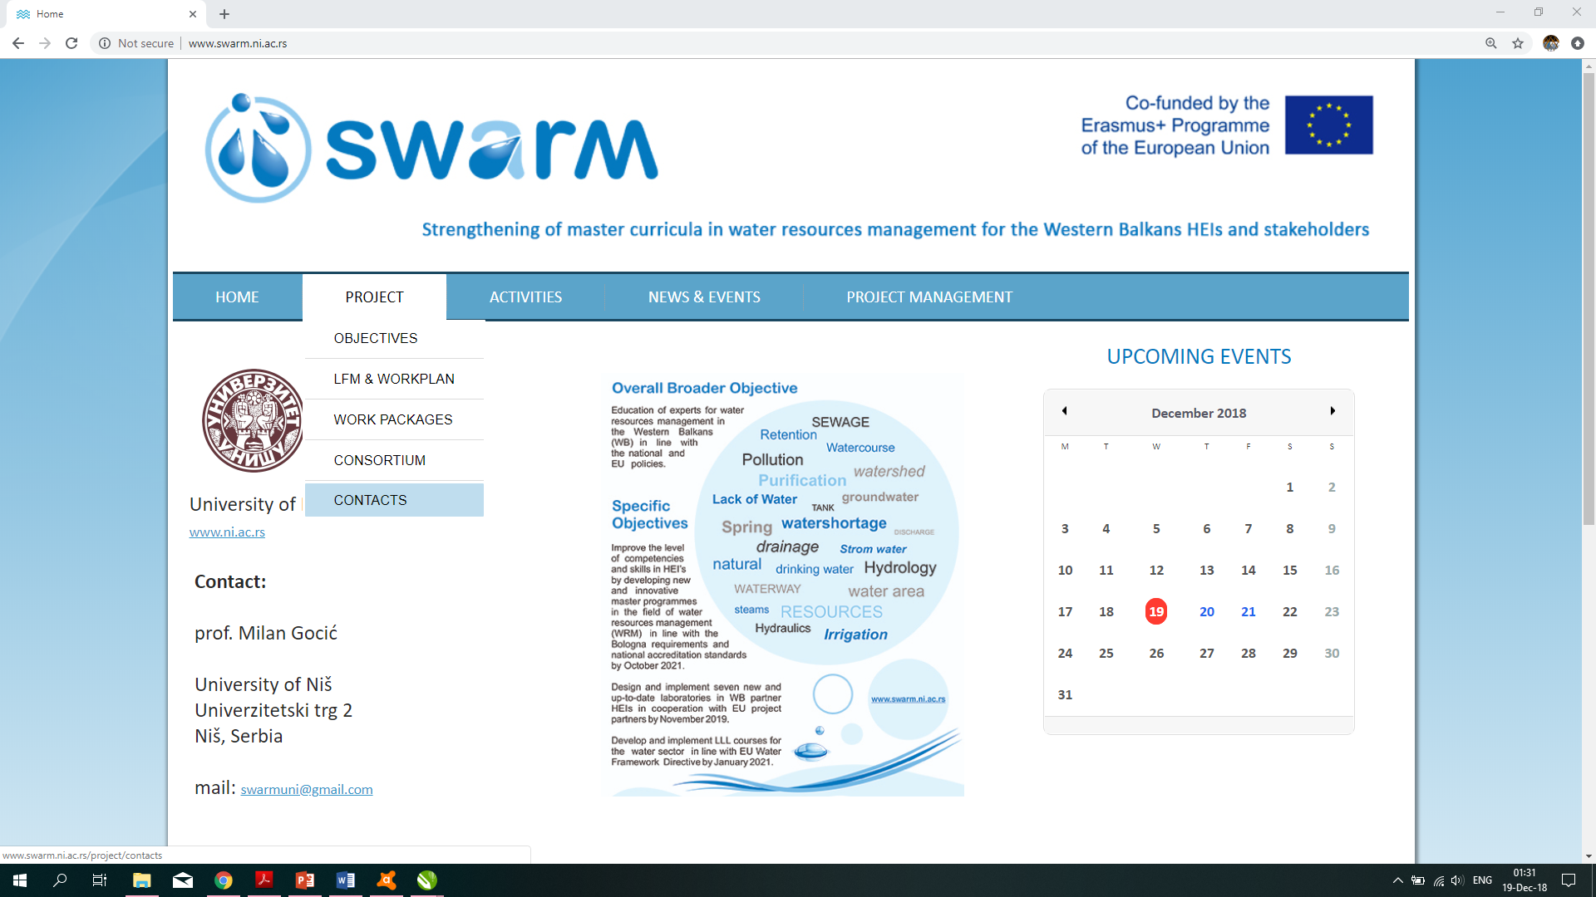
WWW.SWARM.NI.AC.RS
the drop-down menu for
the main project features
Strengthening of master curricula in water resources management
for the Western Balkans HEIs and stakeholders
www.swarm.ni.ac.rs

Slide 7
WWW.SWARM.NI.AC.RS
PROJECT
LFM & WORKPLAN
a .PDF file
to download
Strengthening of master curricula in water resources management
for the Western Balkans HEIs and stakeholders
www.swarm.ni.ac.rs

Slide 8
WWW.SWARM.NI.AC.RS
PROJECT
WORK PACKAGES
each
WORK PACKAGE
shortly explained
Strengthening of master curricula in water resources management
for the Western Balkans HEIs and stakeholders
www.swarm.ni.ac.rs

Slide 9
WWW.SWARM.NI.AC.RS
PROJECT
CONSORTIUM
each
CONSORTIUM MEMBER
shortly presented
Strengthening of master curricula in water resources management
for the Western Balkans HEIs and stakeholders
www.swarm.ni.ac.rs

Slide 10
WWW.SWARM.NI.AC.RS
PROJECT
CONTACT
to personalize each institution
&
to make better connection
Strengthening of master curricula in water resources management
for the Western Balkans HEIs and stakeholders
www.swarm.ni.ac.rs

Slide 11
WWW.SWARM.NI.AC.RS
ACTIVITIES
classified according to WP
time frame for execution
check a current status
forthcoming reports for download
Strengthening of master curricula in water resources management
for the Western Balkans HEIs and stakeholders
www.swarm.ni.ac.rs

Slide 12
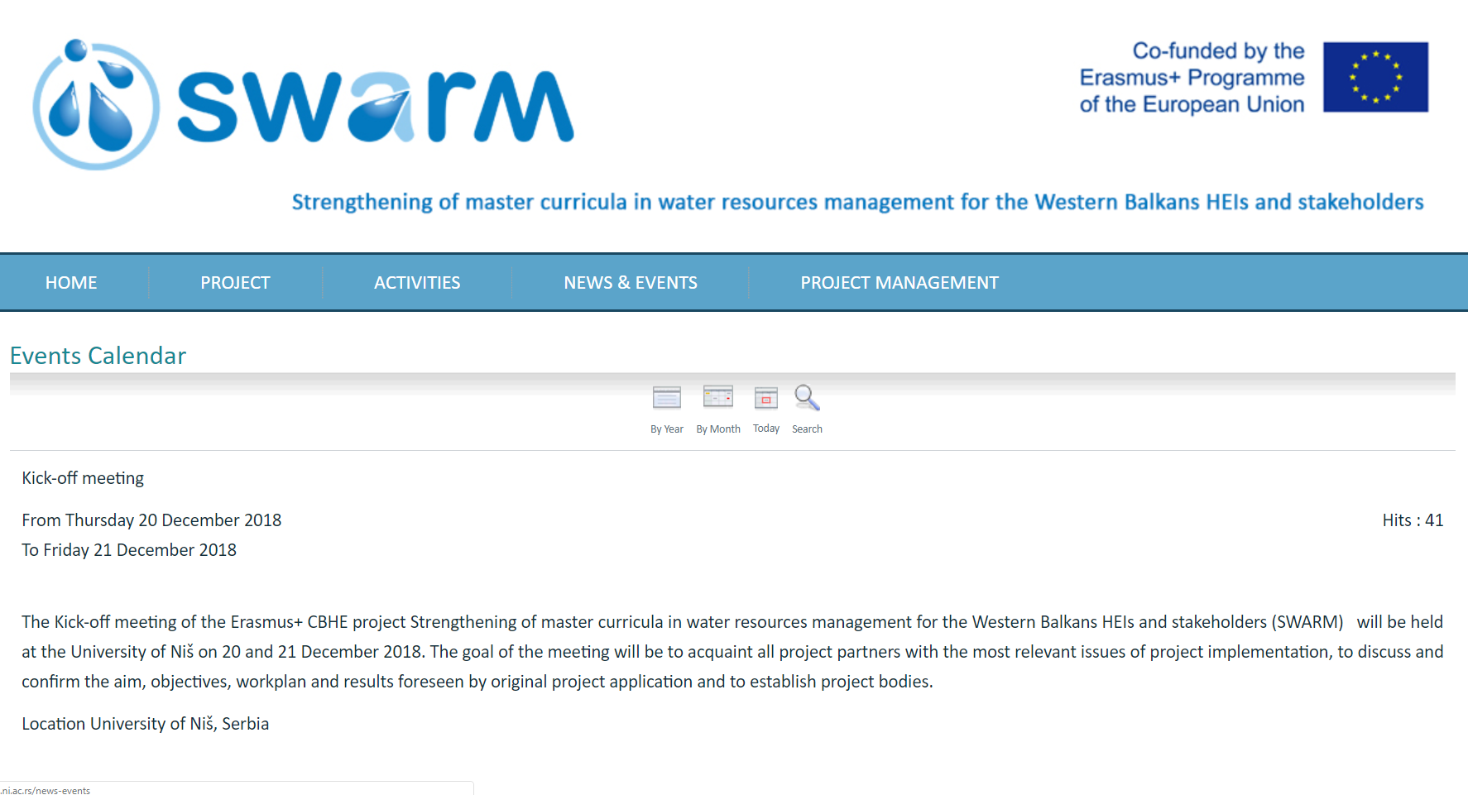
WWW.SWARM.NI.AC.RS
NEWS & EVENTS
news & announcements
forthcoming events
events reports & image galleries
shared information
promotional activities
public calls
public reports
etc.
Strengthening of master curricula in water resources management
for the Western Balkans HEIs and stakeholders
www.swarm.ni.ac.rs

Slide 13
WWW.SWARM.NI.AC.RS
PROJECT MANAGEMENT
an external link to a PROJECT MANAGEMENT PLATFORM
http://mngt.swarm.ni.ac.rs/
Strengthening of master curricula in water resources management
for the Western Balkans HEIs and stakeholders
www.swarm.ni.ac.rs

Slide 14
http://mngt.swarm.ni.ac.rs
to manage
PROJECT FINANCE
to share internal FILES & REPORTS
to control project DEVELOPEMENT
Strengthening of master curricula in water resources management
for the Western Balkans HEIs and stakeholders
www.swarm.ni.ac.rs

Slide 15
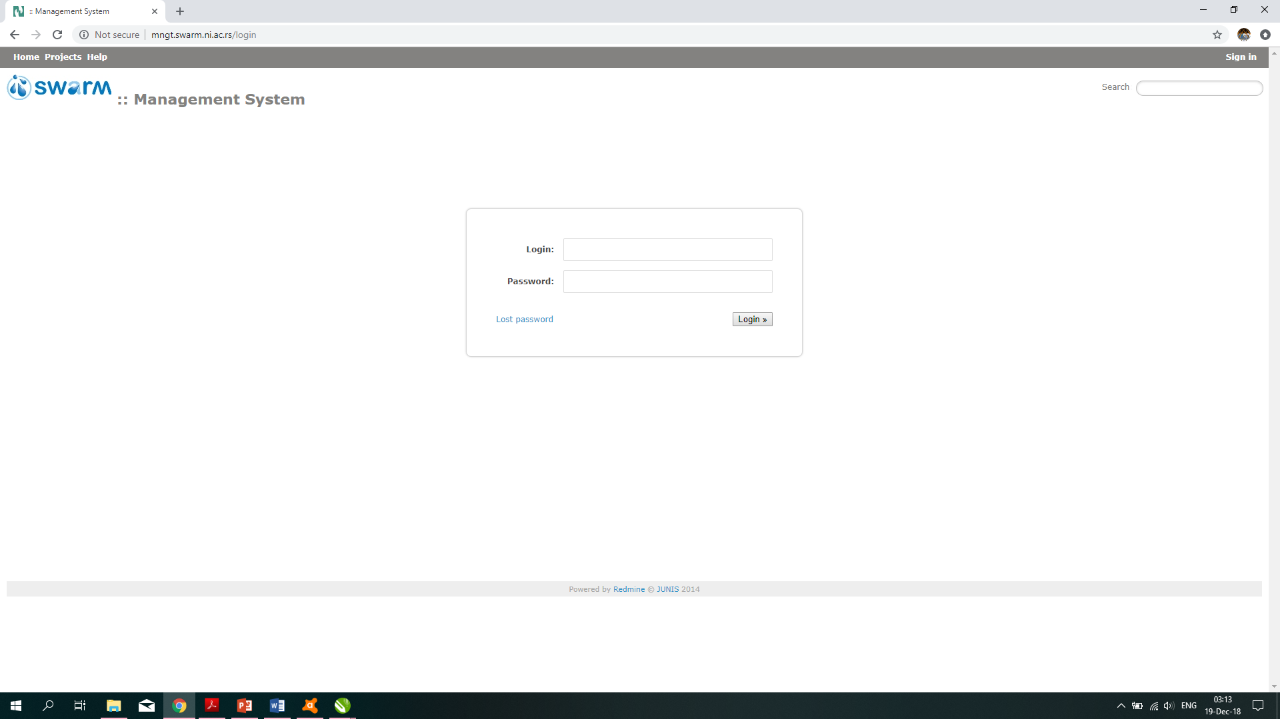
http://mngt.swarm.ni.ac.rs
login username & password needed
access granted for each team member personally
Strengthening of master curricula in water resources management
for the Western Balkans HEIs and stakeholders
www.swarm.ni.ac.rs

Slide 16
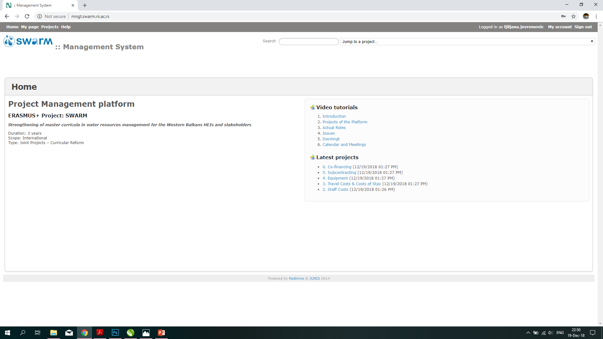
http://mngt.swarm.ni.ac.rs
Tutorials (help) if needed
Latest changes on the project platform
Strengthening of master curricula in water resources management
for the Western Balkans HEIs and stakeholders
www.swarm.ni.ac.rs

Slide 17
http://mngt.swarm.ni.ac.rs
Jump to a specific project section
Strengthening of master curricula in water resources management
for the Western Balkans HEIs and stakeholders
www.swarm.ni.ac.rs

Slide 18
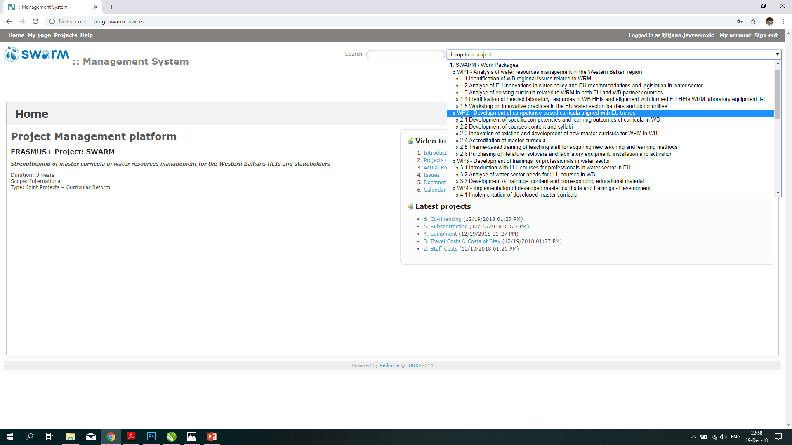
http://mngt.swarm.ni.ac.rs
Drop-down menu to chose
an activity within WP
Strengthening of master curricula in water resources management
for the Western Balkans HEIs and stakeholders
www.swarm.ni.ac.rs

Slide 19
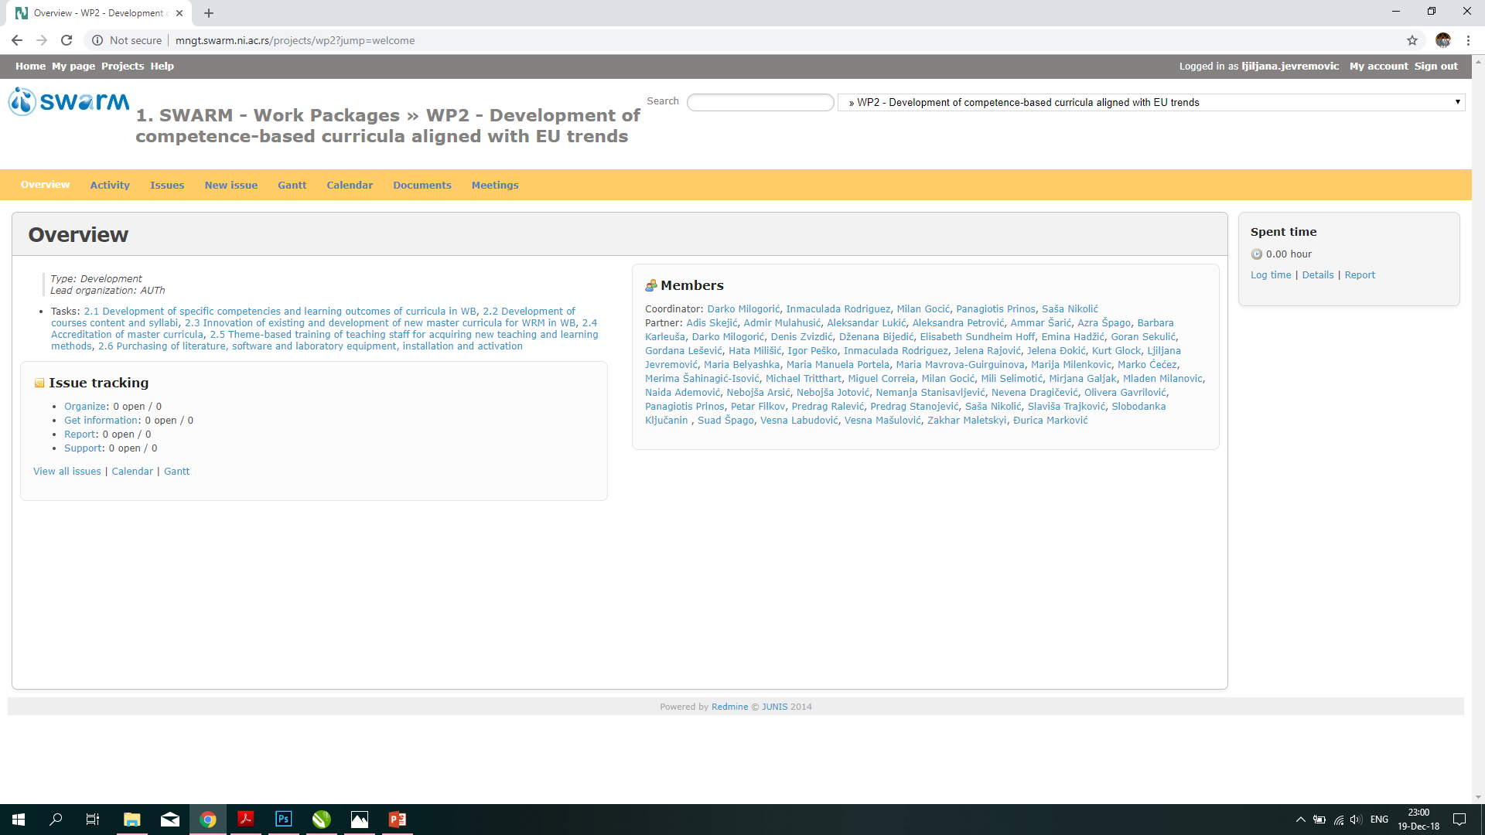
http://mngt.swarm.ni.ac.rs
Strengthening of master curricula in water resources management
for the Western Balkans HEIs and stakeholders
www.swarm.ni.ac.rs

Slide 20
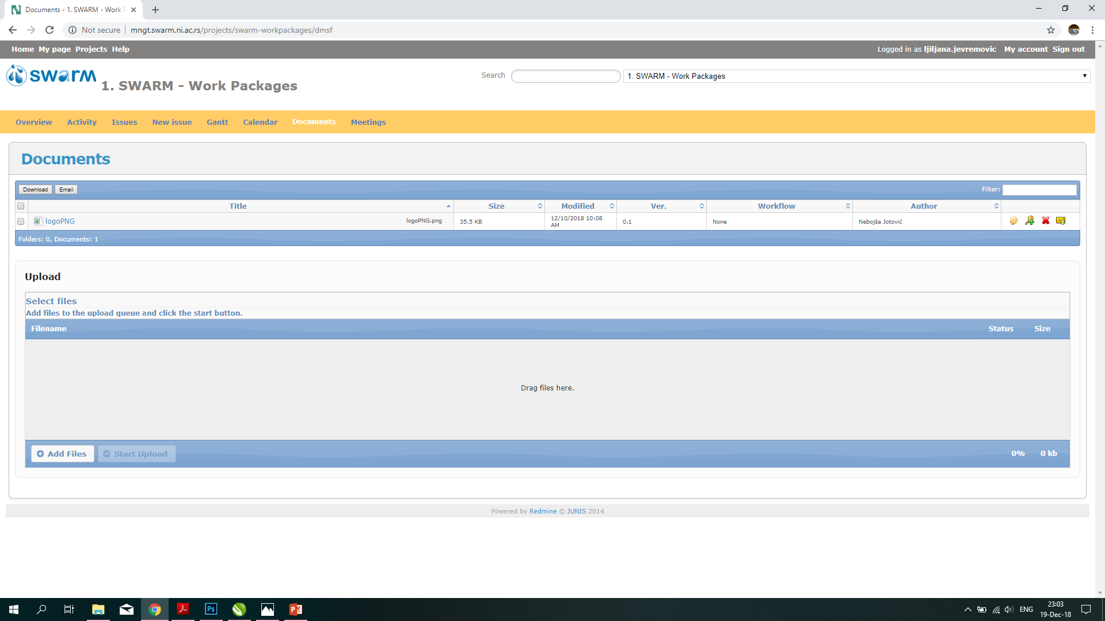
http://mngt.swarm.ni.ac.rs
Strengthening of master curricula in water resources management
for the Western Balkans HEIs and stakeholders
www.swarm.ni.ac.rs

Slide 21
Strengthening of master curricula in water resources management
for the Western Balkans HEIs and stakeholders
www.swarm.ni.ac.rs

Slide 22
WWW.SWARM.NI.AC.RS
Facebook Page → @SwarmUNI
to SHARE
to COLLABORATE
to CONNECT
to PROMOTE
Strengthening of master curricula in water resources management
for the Western Balkans HEIs and stakeholders
www.swarm.ni.ac.rs

Slide 23
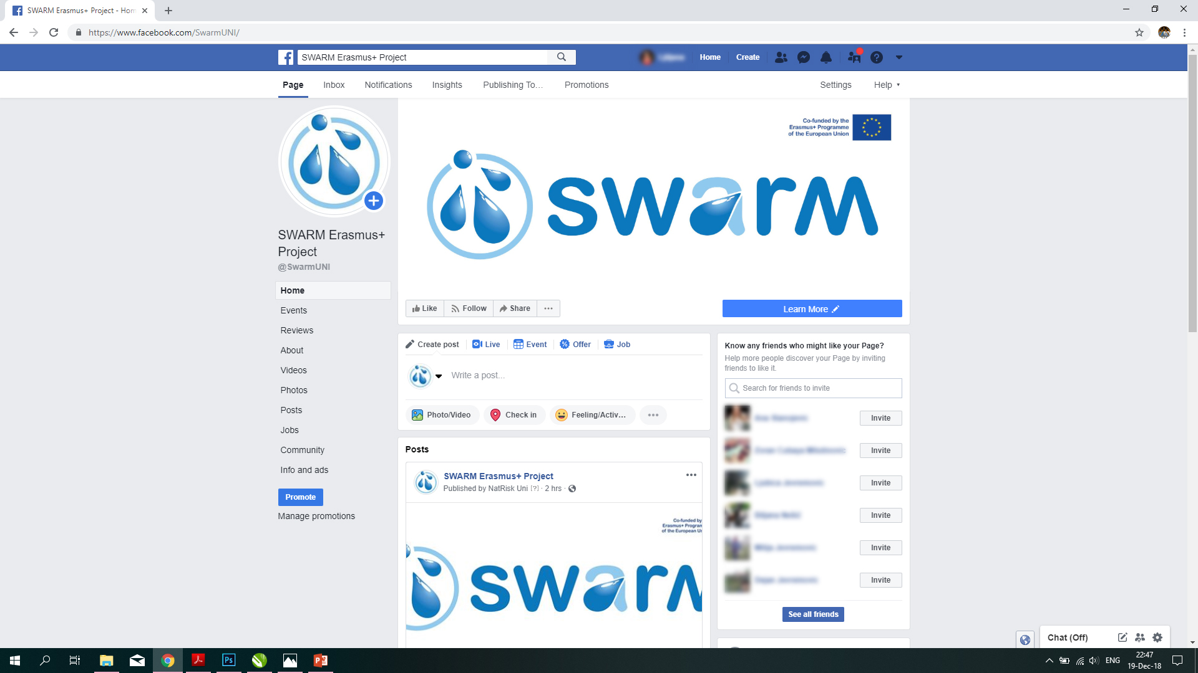
Facebook Page → @SwarmUNI
Strengthening of master curricula in water resources management
for the Western Balkans HEIs and stakeholders
www.swarm.ni.ac.rs

Slide 24
Facebook Page → @SwarmUNI
PUBLICLY SHARED
EVENTS reminders for SWARM Project events
IMAGES and VIDEOS from SWARM Project events
SWARM Project outcomes and achievements
SWARM Project PROMOTIONAL ACTIVITIES
Strengthening of master curricula in water resources management
for the Western Balkans HEIs and stakeholders
www.swarm.ni.ac.rs

Slide 25
WWW.SWARM.NI.AC.RS
Facebook Page → @SwarmUNI
Strengthening of master curricula in water resources management
for the Western Balkans HEIs and stakeholders
www.swarm.ni.ac.rs

